Slide 1
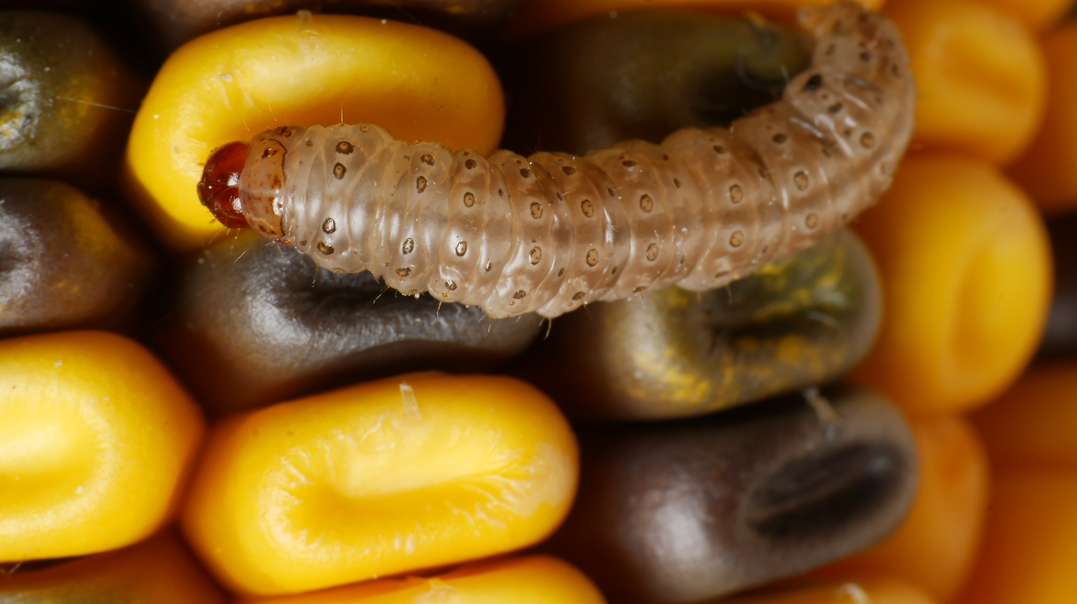
Diapause Preparations and Stored Resources
-James T. Brown
Notes:
The relationship between stored resources and diapause timing

Slide 2
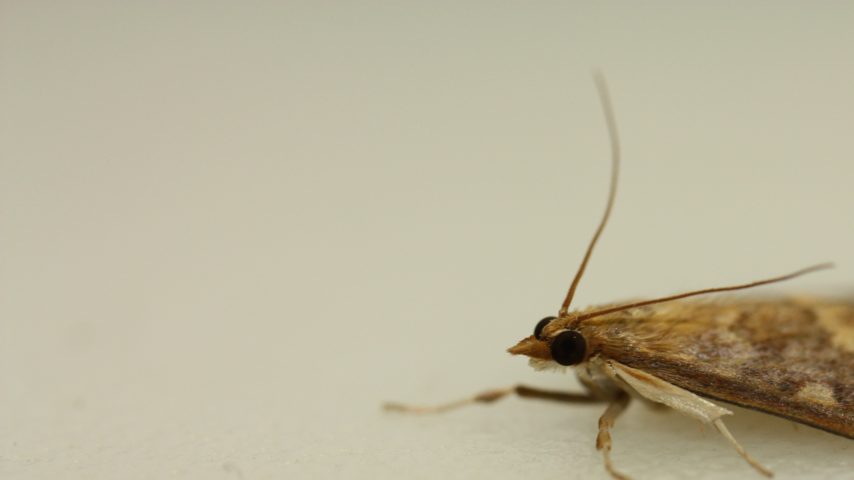
Outline
Environment
European corn borer
Experiment & Predictions
Implications & Future Directions

Slide 3
Environment

Slide 4
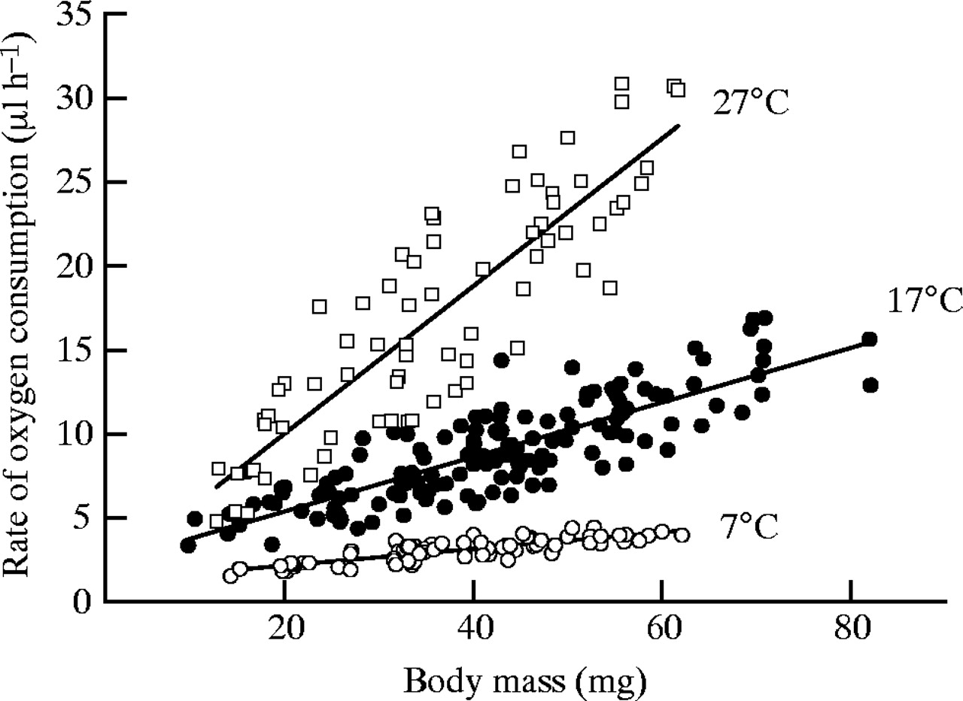
Temperature Determines Insect Activity
Oxygen consumption and body mass in crickets
Insects are ectotherms
Metabolic rate is proportional to external temperatures
Metabolic rate determines activity levels
R. F. Nespolo et al. J Exp Biol 2003;206

Slide 5
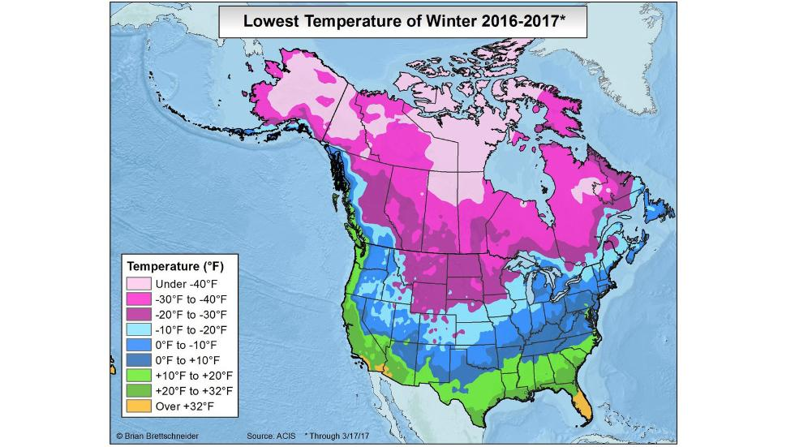
Temperatures differ geographically, BUT winter temperatures differ MORE!
10ᵒF Difference
40ᵒ-50ᵒF Degree Difference
Insects evolve to cope with winter
Notes:
Say: as temps rise, min temps will increase, and all seasons will get warmer and as all seasons warm> summers will become hotter than average and fall temps will
Extreme min temps vary more than extreme max temps
Map of US with suns and father winter
Winter temperatures vary geographically more than summer temperatures
Increased summer temperatures leading into fall and winter effectively increase growing seasons
Extreme maximum temperatures vary less than extreme minimum geographically.
[graphic of miami/quebec example Caroline paper and steven chown ]
Winters constricts the geographical distributions of many species
Understanding the interaction between species in the context of warmer winters will shape our understanding increasing temps will effect them
Bonan 2013
Williams et. al 2015
Chown et. al

Slide 6
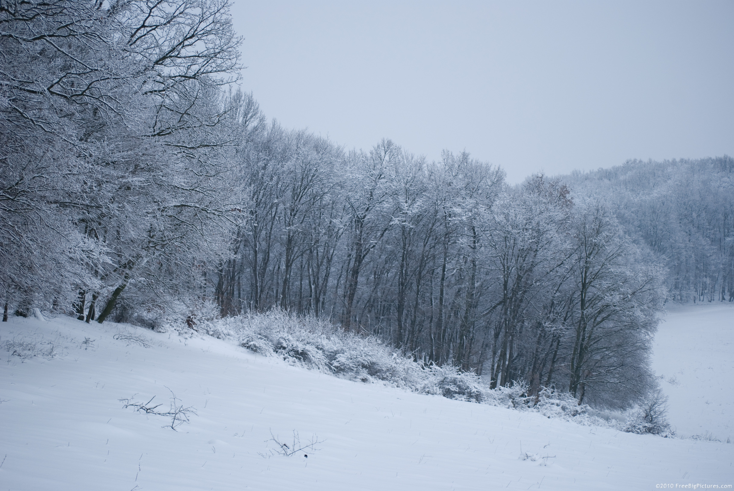
Harsh Winter…
Low metabolic rate
Limited or absent resources
Risk of desiccation
http://freebigpictures.com/
Notes:
Energy is used to power metabolic activity
Releasing that energy is
Ectotherm metabolism is directly proportional to external temperatures
Insects that are active during the winter use more energy
http://freebigpictures.com/
Winter active species
Genetically programmed dormancy/hibernation/diapause
many species, insects in particular, use some form of dormancy to escape winter conditions but…

Slide 7
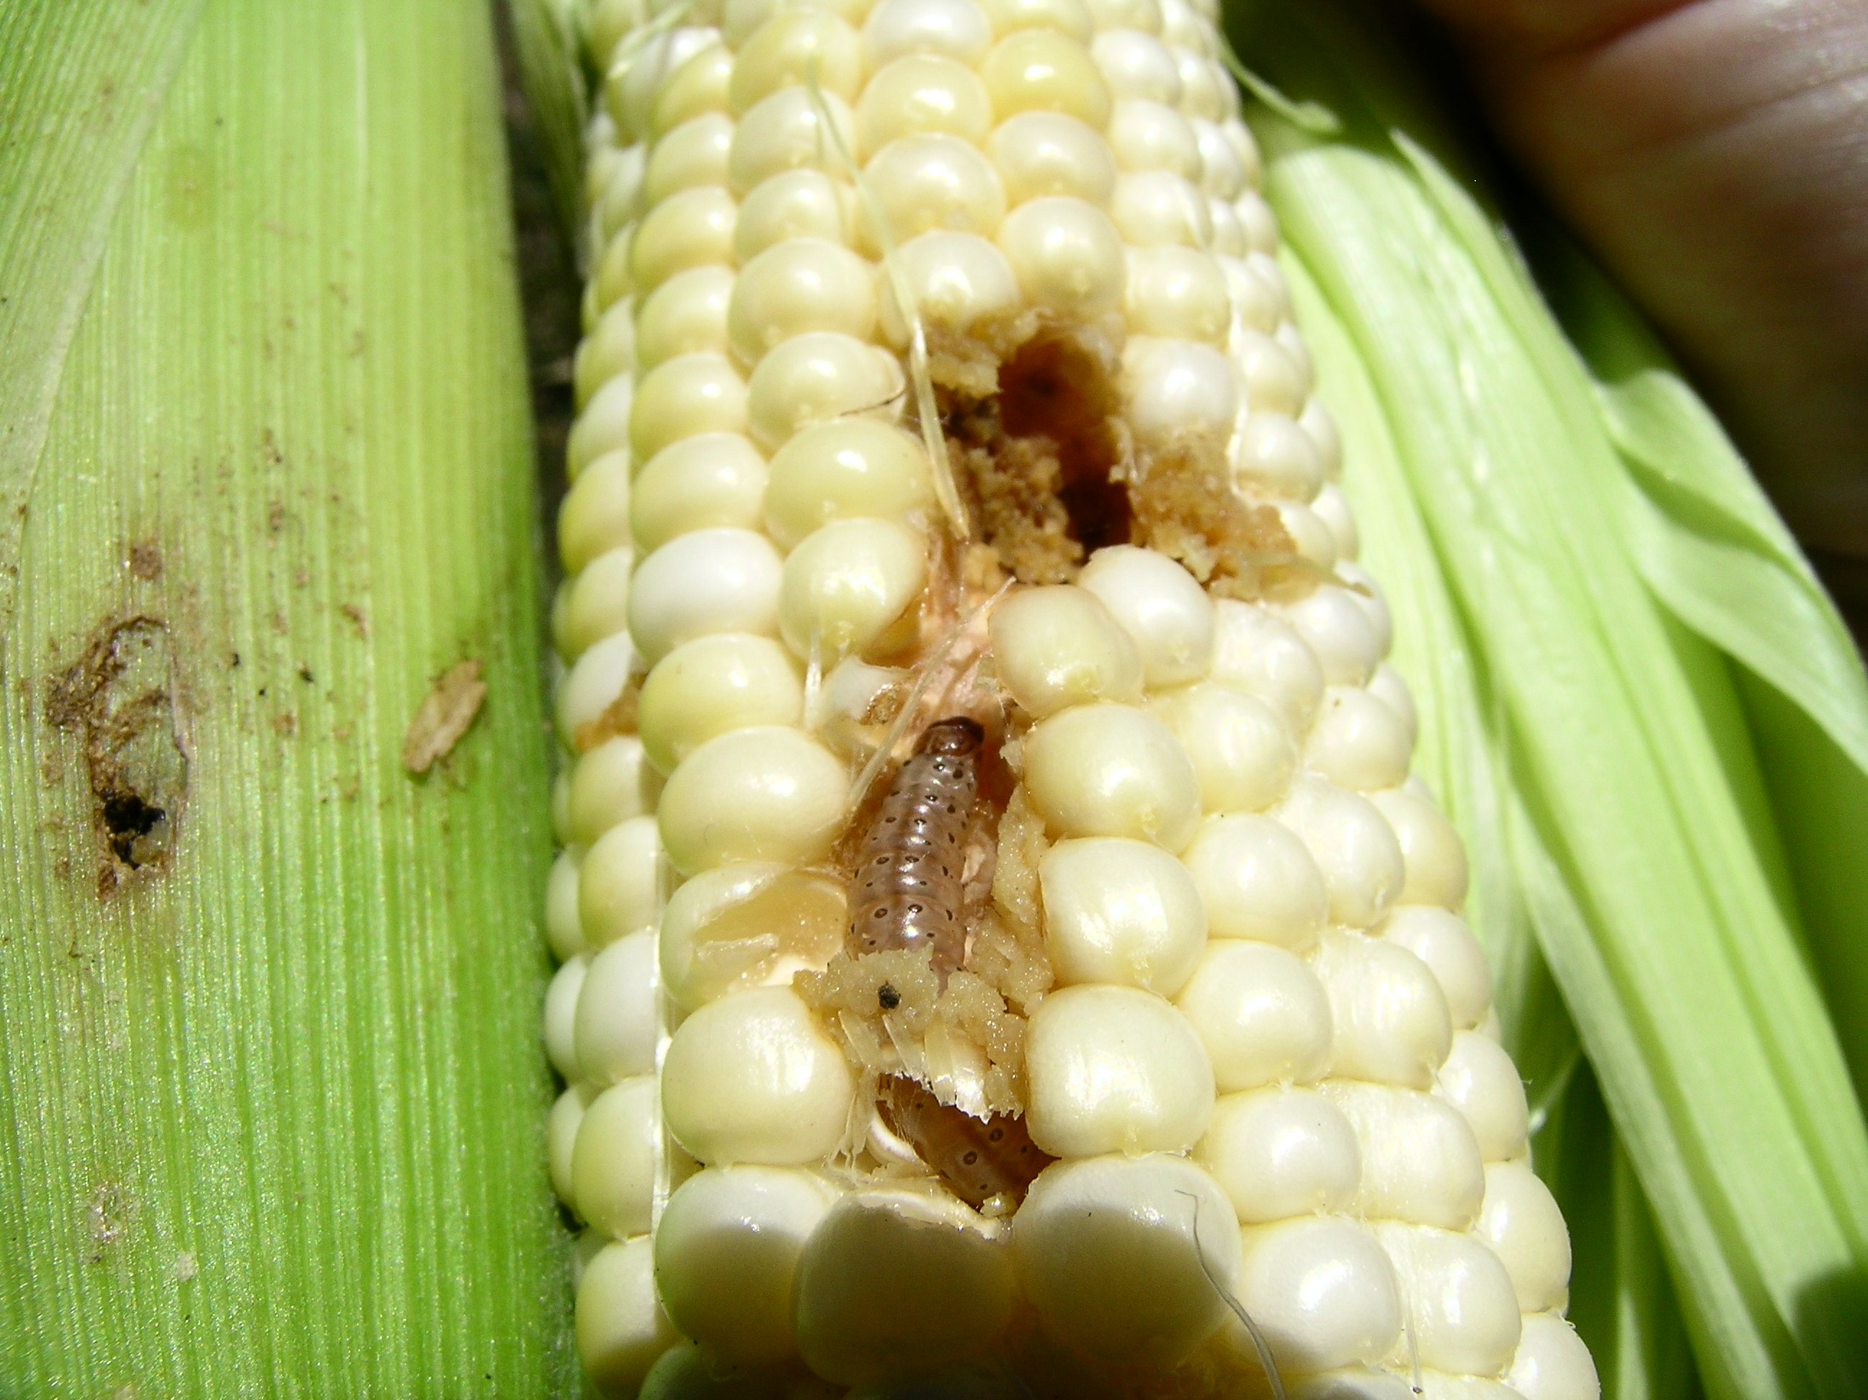
Avoid it with Diapause
Programmed period of suspended development
Synchronizes insect life history with their environment
How? Stored Resources
Fat, Sugar, and Proteins
Triglycerides
Carbohydrates
Proteins

Slide 8


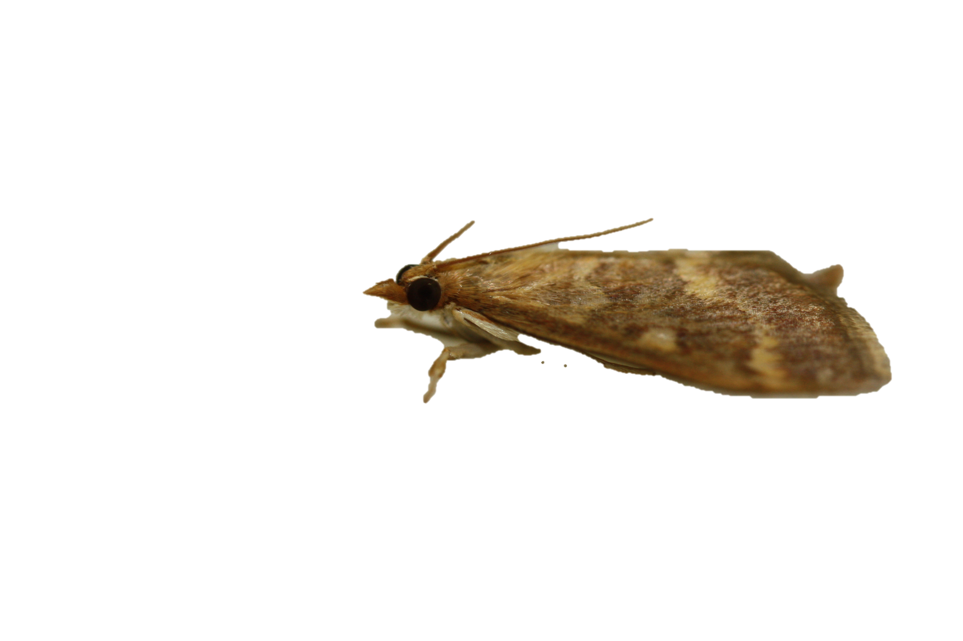
What season is it? Should I prepare for diapause?
?
?
?
?
?
?
?
?
?
?
?
?

Slide 9
Photoperiod
Used by temperate animals to prepare for winter
The number of daylight hours in 24hr cycle
Historically, photoperiod has reliably predicted seasonality
Summer: 6pm
Winter: 6pm
Notes:
Environmental conditions/resources are cyclic
Environmental cues are cyclic and consistent
Environmental cues are perceived by insects
Insects monitor environmental cues to predict changes in environmental conditions/resources
In temperate regions many insects rely on photoperiod

Slide 10
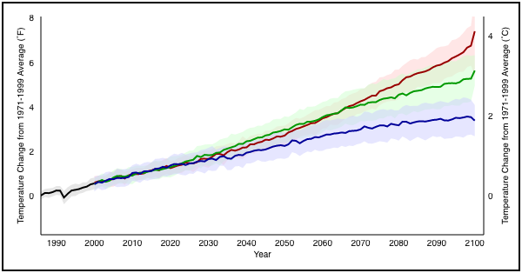


Climate Change: Global Temperature Projections
Increase between 1.1°C and 5°C
Notes:
Warmer temperatures are predicted through the year 2100

Slide 11
Climate Change
Longer growing seasons
Fall and spring temperatures more variable
Warmer and shorter winters
Shifts in the timing of insect activity versus dormancy
Question: As cool seasons warm, how will insects respond as temperatures increase?
Timing of pests, beneficial insects, pathogens, etc.

Slide 12
European corn borer
Model system to study questions about seasonal timing shifts.

Slide 13
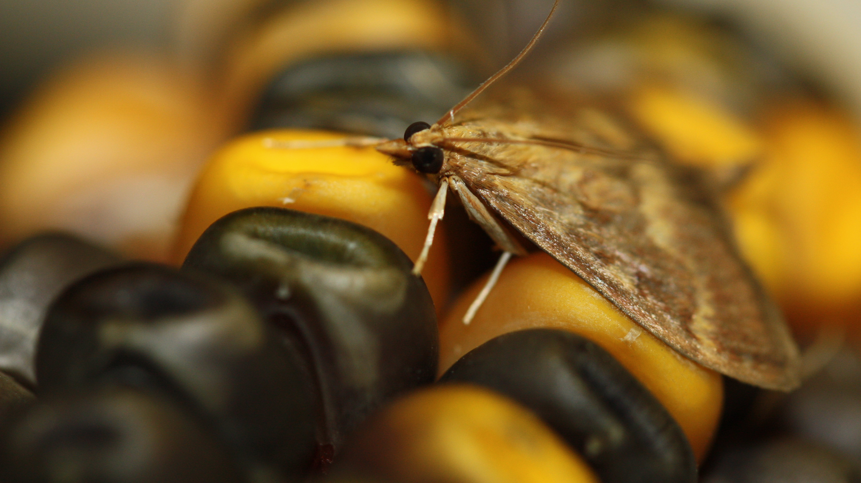
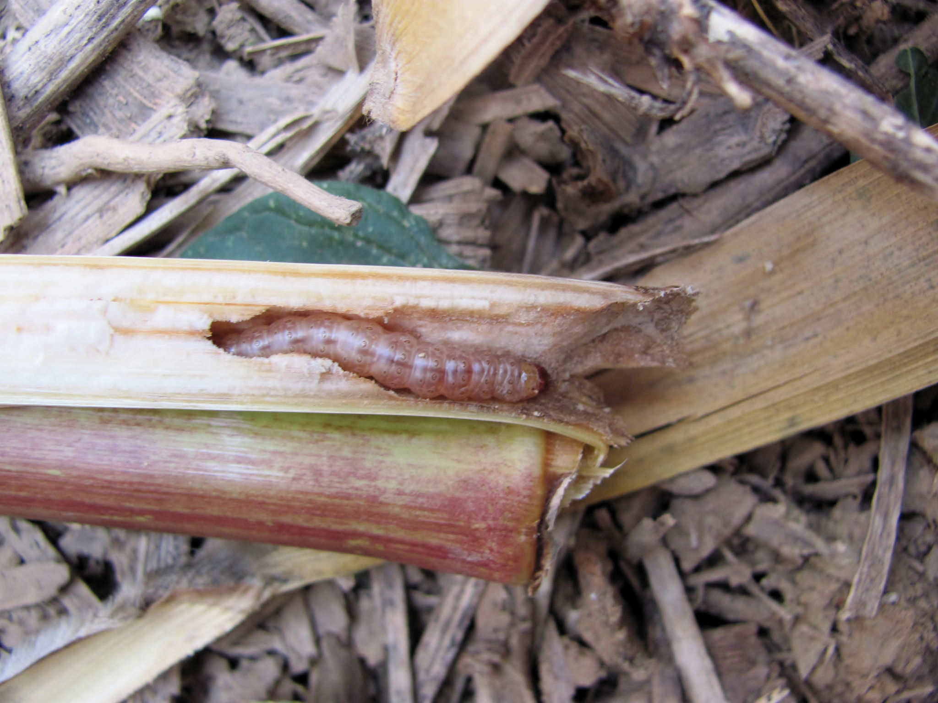
European corn borer, ECB (Ostrinia nubilalis)
Currently a major agricultural pest in corn
$1 Billion in annual losses due to yield reduction and pest management
Image: Eric Bohnenblust/Penn State
Notes:
Crop losses and management of ECB in 2001 exceeded 1bil dollars
threshold: 10 moths in black light trap

Slide 14
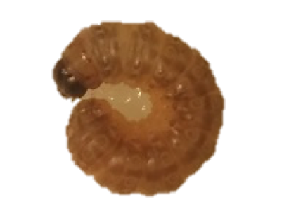
Summer Growing Season | Cool Fall Season
Eggs
Larva
Pupa
Adult
Eggs
Adult
Larva

Slide 15
ECB Pre-diapause
Induction:
5th instar ECB perceive short photoperiod
Preparation:
Diapause destined larva begins storing resources
PRE-DIAPAUSE

Slide 16
Resources
Fat: Main fuel diapause, and serve as structural molecules.
Sugar: Common energy reserve
Proteins: used during post diapause development.
Triglycerides
Carbohydrates
Proteins
Hahn & Denlinger, 2007; Areese & Soulages, 2010;
Notes:
In preparation for diapause, insects need to store energy, energy in the form of proteins and trighyceride lipids.
Protein Storage:
respiratory metabolism resivoir
intermediary metabolism aminos
Lipid Storage: (Arrese and Soulages 2010, Hahn and Denlinger 2007)
Triglycerides are stored in anhydrous and more compact
the major fuel of diapause
Fatty acids stored in the form of triglycerides
energy is released though beta-oxidation
fuel for flight
phospholipids and waxes
more than 90% of lipids are stored are tryglycerides
synthesized from food intake: fatty acids, carbs, proteins
While some insects eat use some of the same foods we use to build up these stores of energy rich molecules, they like their food straight from the ground.
As temps warm, some insects will be advantaged

Slide 17


Diapause
Initiation:
Development is arrested and metabolism is suppressed
Maintenance:
Continuation of arrested development and suppressed metabolism
Termination:
Endogenous factors maintaining diapause are relieved

Slide 18


Diapause
Initiation:
Development is arrested and metabolism is suppressed
Maintenance:
Continuation of arrested development and suppressed metabolism
Termination:
Endogenous factors maintaining diapause are relieved

Slide 19
Diapause
Initiation:
Development is arrested and metabolism is suppressed
Maintenance:
Continuation of arrested development and suppressed metabolism
Termination:
Endogenous factors maintaining diapause are relieved

Slide 20

ECB Post-Diapause
Post-Diapause Development
Perception of exogenous factor
Diapause ends and allows development to resume
Larval-Pupal metamorphosis begins

Slide 21
Resource Sinks for Limited Resources
Lipids
Pre-Diapause
Resource Gathering
Diapause
Cryoprotection
Metabolism
Repair
Post-Diapause
Development
Adult Functions
Carbohydrates
Proteins
Diapause
Adapted From: Sinclair, Journal of Thermal Biology 54 (2015)
Notes:
In preparation for diapause, insects need to store energy, energy in the form of proteins and trighyceride lipids.
Protein Storage:
respiratory metabolism resivoir
intermediary metabolism aminos
Lipid Storage: (Arrese and Soulages 2010, Hahn and Denlinger 2007)
Triglycerides are stored in anhydrous and more compact
the major fuel of diapause
Fatty acids stored in the form of triglycerides
energy is released though beta-oxidation
fuel for flight
phospholipids and waxes
more than 90% of lipids are stored are tryglycerides
synthesized from food intake: fatty acids, carbs, proteins
While some insects eat use some of the same foods we use to build up these stores of energy rich molecules, they like their food straight from the ground.
As temps warm, some insects will be advantaged

Slide 22
Stored resources are needed to survive diapause and post diapause development,
Question: How are diapause length polymorphisms and voltinism associated with stored resources?

Slide 23
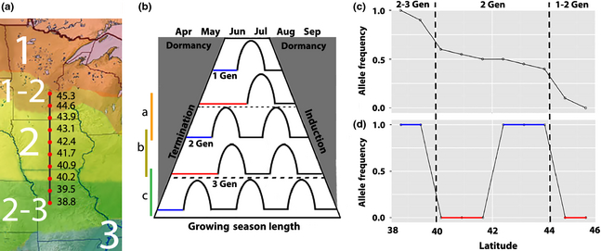
Voltinism Varies with Latitude
Genetic Differences in Voltinism
Univoltine
Bivoltine

Slide 24
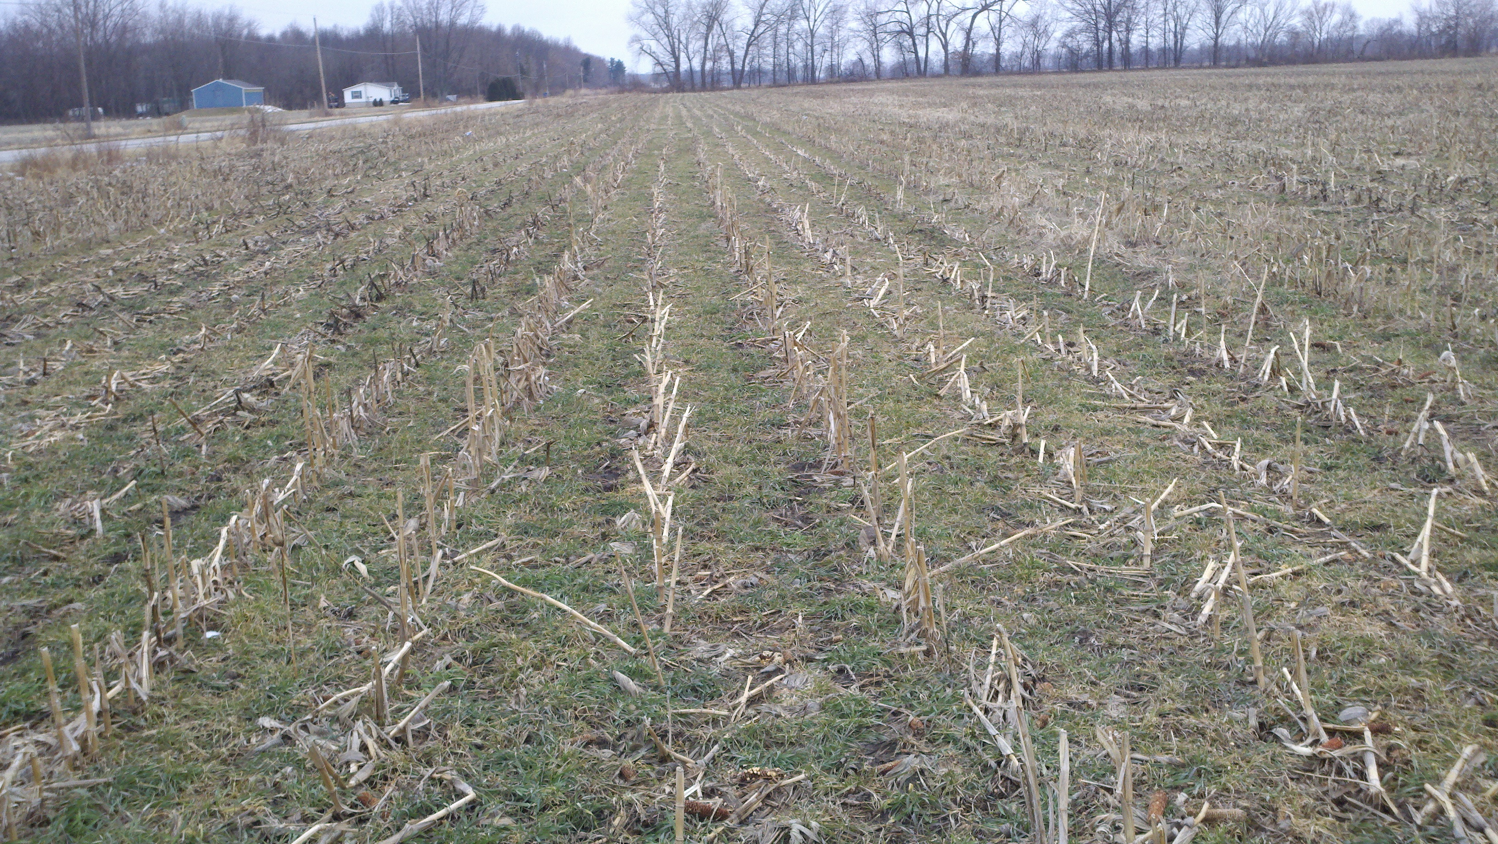
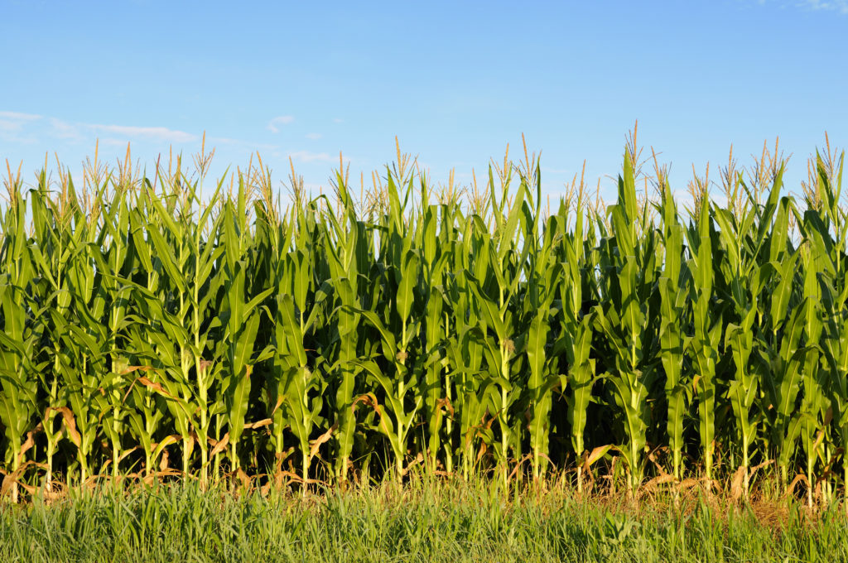

Life History
http://corncorps.com/2016/01/14/5-things-about-this-photo-an-illinois-landscape/cornfield-background/
JAN | FEB | MAR | APR | MAY | JUN | JUL | AUG | SEP | OCT | NOV | DEC
One generation = Limited Damage
Notes:
Start of growing season → Larvae exit diapause, develop into pupa, then adults
During growing season → Eggs hatch, larvae eat, and grow
End of growing season → Ultimate instar larvae enter diapause

Slide 25
Longer Growing Season
http://corncorps.com/2016/01/14/5-things-about-this-photo-an-illinois-landscape/cornfield-background/
JAN | FEB | MAR | APR | MAY | JUN | JUL | AUG | SEP | OCT | NOV | DEC
More generations = More money
$$$$$$$$$$$$$$

Slide 26
Increased Temperatures = Warmer AND Shorter winters
Insects will be challenged by BOTH warmer and shorter winter.
The balance between winter duration and winter warmth will effect insect survival.
If stored resources are too low the warmer shorter winter could still deplete those resources

Slide 27
Experiment and Predictions

Slide 28
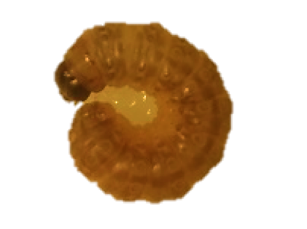
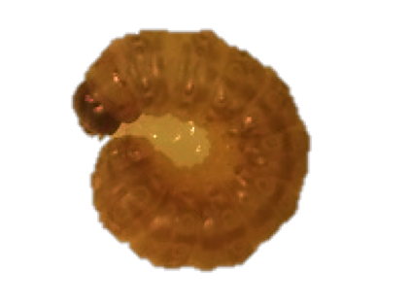
Two Genotypically Distinct Polymorphisms of ECB
Univoltine-Z Strain:
1 annual generation
Long Facultative Diapause
Bivoltine-E Strain:
2 annual generations
Shorter Facultative Diapause

Slide 29
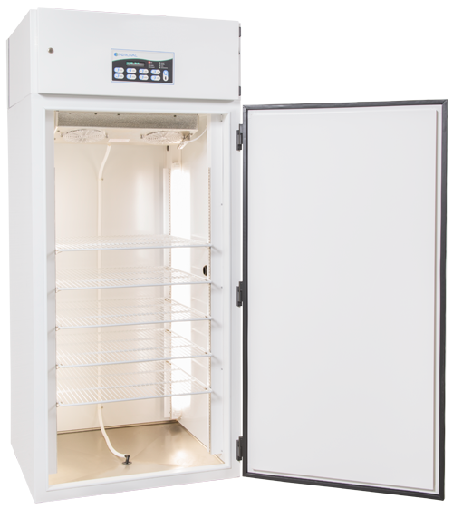
Hypothesis: Longer diapausing ECB accumulate more triglycerides than the shorter diapausing and non-diapausing ECB.
Summer
Fall
Notes:
Diapause initiation and genetically pre-determined diapause length dictate the accumulation of resources

Slide 30
Summer
Fall
Short Diapause
Long Diapause
Prediction 1: Stored resources does not differ
Inference: resource storage is NOT a function of photoperiod or diapause length
Summer
Fall
Notes:
Energy storage is not being set by photoperiod but rather energy depletion is being set by photoperiod or diapause length

Slide 31
Summer
Fall
Short Diapause
Long Diapause
Prediction 1: Stored resources does not differ
Non Diapause
Diapause
NULL

Slide 32
Summer
Fall
Short Diapause
Long Diapause
Prediction 2: Stored resources increased in diapausing larvae
Inference: resource storage is ONLY a function of photoperiod sensitivity.
Summer
Fall
Notes:
Diapause length is unimportant and those larvae going into diapause will have similar increases in lipids and proteins

Slide 33
Summer
Fall
Short Diapause
Long Diapause
Prediction 2: Stored resources increased in diapausing larvae
Non-Diapause
Diapause

Slide 34
Summer
Fall
Short Diapause
Long Diapause
Prediction 3: Stored resources differs by photoperiod and ecotype
Inference: resource storage is a function of BOTH diapause length and photoperiod
Summer
Fall

Slide 35
Summer
Fall
Short Diapause
Long Diapause
Prediction 3: Stored resources differs by photoperiod and ecotype
Non-Diapause
Diapause

Slide 36
Summer
Fall
Short Diapause
Long Diapause
Different Photoperiods
23ᵒC
16 L:D
23 ᵒ C
12 L:D
Summer
Fall

Slide 37
Shared Developmental Stage
Diapause
Non-diapause
Diapause and non diapause larvae enter wandering stage
Wandering stage larvae terminate feeding
Stored resources at their peak during wandering stage
WANDERING STAGE

Slide 38
Characterizing Triglycerides
Larva Sample
Notes:
Quantification
HPLC-ELSD to quantify TAG in larval samples
Identification
GC-FID to identify methylated TAG samples

Slide 39
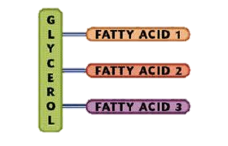
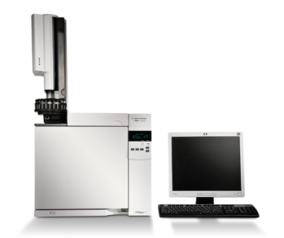
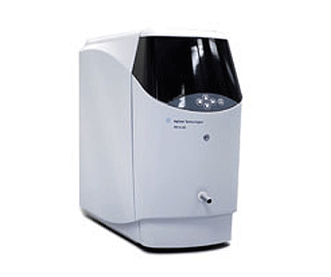
LC-ELSD
GC-FID
Quantification
Identification
http://www.agilent.com/en-us/products/

Slide 40
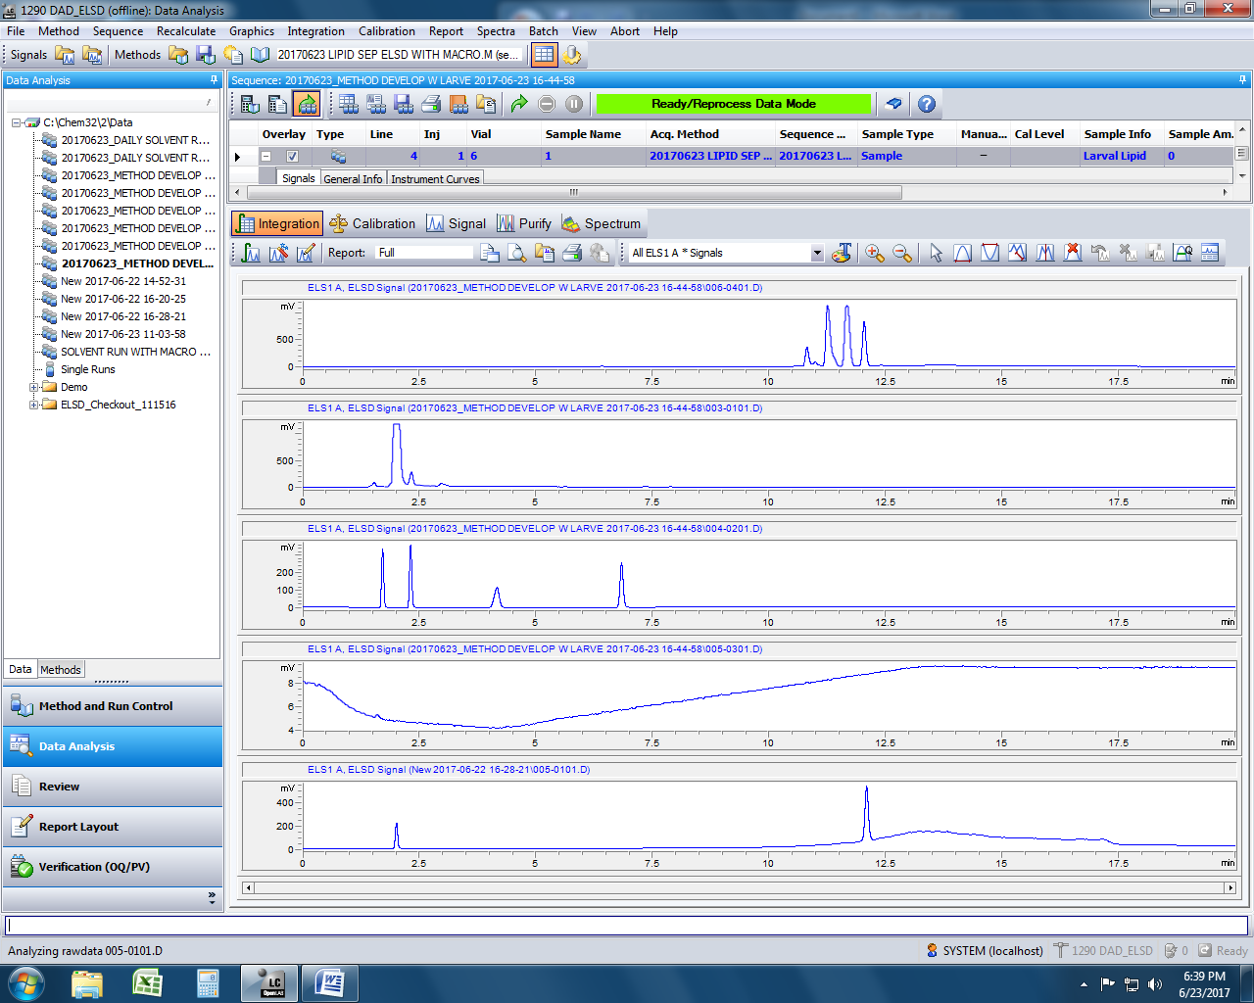
Quantify Triglycerides
Larva Triglyceride
Triglyceride Standard

Slide 41
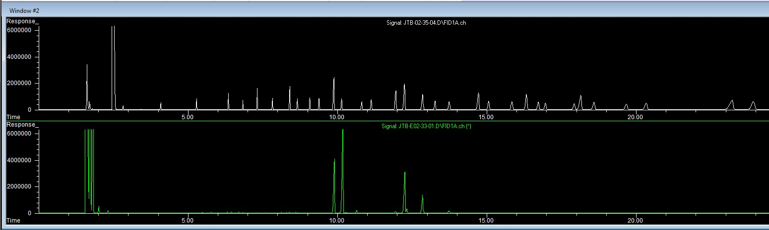
Identifying Lipids: GC-FID
C16:0
C18:1n9c
Identify Fatty Acid Chains
C16:1
C18:2n6t
Notes:
C18:0 Palmitic
C18:1 Palmitoleic
C18:1n9c Oleic
C18:2n6t

Slide 42
Preliminary Data: UZ Strain Comparisons
Dry Mass
Total Lipid Mass
df=18, p-value = 0.002
df=8, p-value = 6.097E-5
Notes:
Dry Weight comaprison: Two sample T-test shows sig in dry weight in dia vs nondia UZ (feb samples)
Total Lipid
Dry total lipid weight comparison: Two sample T-test shows sig diff in dry lipid weight in dia and non dia UZ (june samples)

Slide 43
Summer
Fall
Short Diapause
Long Diapause
Prediction 2: Stored resources increased in diapausing larvae
Summer
Fall

Slide 44
Implications

Slide 45
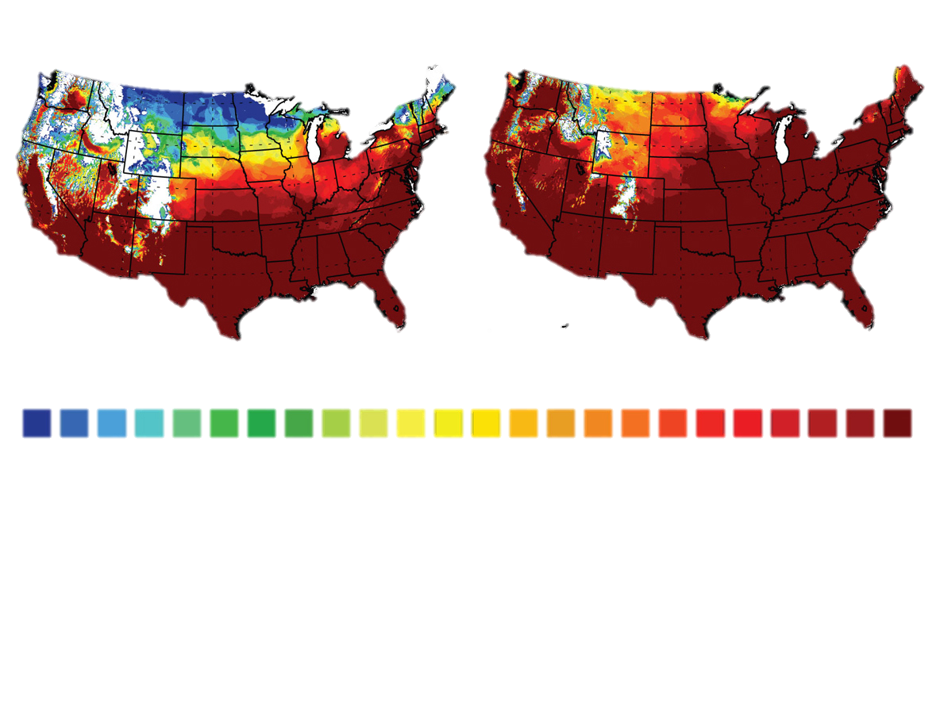
IPM Strategy
Predicting pest populations
Linking energy state to diapause
Finding the minimum energy required to survive diapause
1 | 2 | 3 | 4 | 5 | 6 | 7 | 8 | 9 | 10 | 11 | 12 | 13 | 14 | 15 | 16 | 17 | 18 | 19 | 20 | 21 | 22 | 23 | 24
20th Century
21st Century
Purdue Climate Change Research Center
Diffenbaugh, N. et al. Envirn Resrch Ltrs, 2008;3
Notes:
Basically, we examined both the number of days warm enough for the pests to grow and the number of days cold enough to kill the pests, assuming the pests' documented climate tolerances remain the same," Krupke said. "This tells us what could happen in projected future climates. However, the model cannot take into account the dynamic nature of any ecological system. There are significant additional factors that could come into play such as interaction of the pests with the environment, relocation of corn and other crops and changing human management of the pests.

Slide 46
IPM Strategy
Reduced synchrony with environment leading to ecological suicide
Linking energy state to diapause
Finding the minimum energy required to survive diapause
Characterizing stored resources is just the beginning
More work needs to be done to understand how stored resources diapause.
How does the quantity and composition of stored resources effect diapause survival?
Notes:
Take the information about the character of the energy state of ECB and chase this concept of minimal energy required to survive diapause and work to characterize that energy state….Does it look something like this graph on this slide where percent survival gradually decreases as “diapause energy” is reduced?

Slide 47


Questions?

